Slide 1
Imagining the Impossible
in a time of Climate and Nature Crisis
Methodist Synod
April 2023
Andy Lester -- A Rocha UK

Slide 2
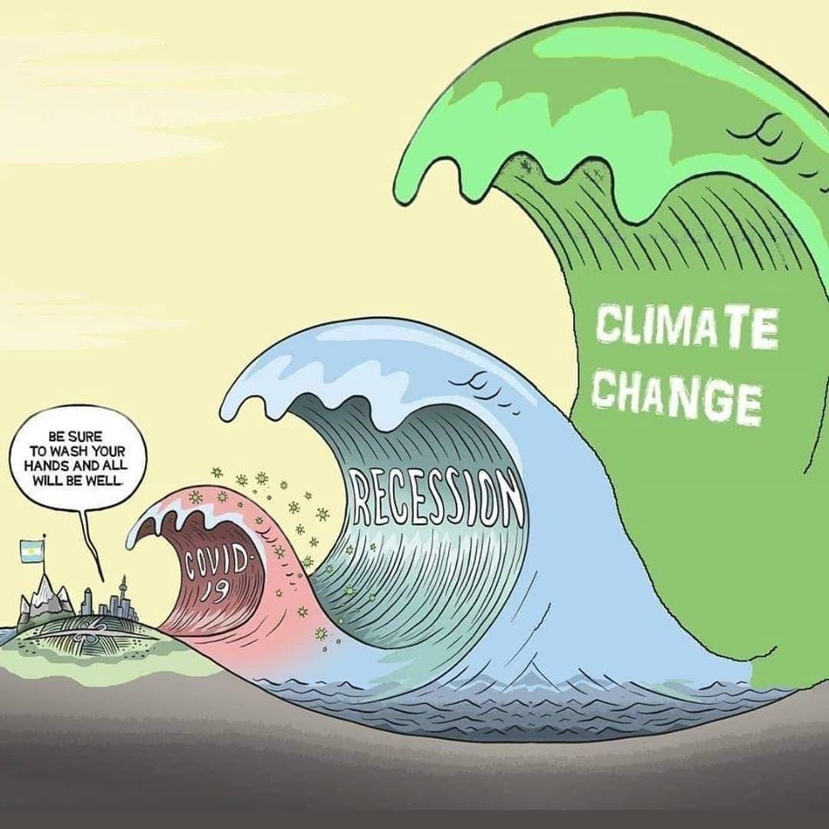

Slide 3
If you could list the top 5 things that concern you most about the situation we are in what would they be? Start with the really big one for you, then list up to another four . . .

Slide 4
An autumn 2021 global survey led by Bath University (published in the Lancet) spoke to 10,000 people globally under 25
1) 75% see the future as frightening
2) 65% feel governments have failed younger people on climate
3) 60% are extremely worried about the impacts of climate change
4) 56% believe that humanity is doomed
5) 45% are impacted every day by feelings of sadness and loss on the planet situation

Slide 5
Knowing what the problem is only the start of the conversation- Let’s pause and ask the question: What gives you hope for our uplands in a time of crisis?

Slide 6
Living differently means Re-Earthing ourselves and our communities

Slide 7
Re-Earthing our communities in 5 steps
Stop
Plot
Sow
Grow
Harvest

Slide 8
The 2 elements of STOP
What are the facts?
My personal journey

Slide 9
Climate Facts
Global temperature is 1.2C above the long term average
Rise of temperature is highest over the Sub-Arctic and Antarctic areas, and here the average rise is significantly higher
According to the UN the climate crisis is helping to accelerate species loss. Currently thought to be at least 1,000 times higher than the “expected” rate of extinction (over 200 species a day is likely)
COP26 will not be enough to stop the rise in CO2 or methane
We are still on course for a global rise of between 2 and 3C by the end of the century. This will be catastrophic for food and water supplies

Slide 10
Facts on the disconnection from nature . . .
75% of children spend less time outside than prison inmates (1).
90% reduction in the area that children explore and play in during their leisure time over the past 20 years. (2).
One in five children don’t play outside on an average day at all (3).
One in nine children had not set foot in a park, forest, beach or any other natural environment for at least a year (4).
Four out of five children in the UK were not adequately connected to nature (5).
Less than one in 10 children regularly played in wild spaces, compared to half of children a generation ago (6).
Only 10% of children have access to outdoor learning (7)

Slide 11
Sources for disconnection facts
1/3 “Dirt is Good” campaign by Persil UK 2020/21 persil.com/uk/dirtisgoodproject.html
2/4 Monitor of Engagement with the Natural Environment Survey 2018-19 (MENE)
5 RSPB report 2013 on the Impact of Children's Connection to Nature: rspb.org.uk>positions>education
6 National Trust Report 2012. Natural Childhood Report by Stephen Moss
7 https://www.gov.uk/government/news/new-plan-for-national-parks-gives-every-schoolchild-a-chance-to-visit

Slide 12
But the gloomy stats hide a silver lining . . .there are alternative facts
According to Natural England People and Nature Survey 2021:
1) 83% of 8-16 year olds said they were happy in nature
2) 70% said they would spend more time outside as Covid restrictions ease
3) 82% want to do more in nature
4) 50% are motivated by being quiet in nature as opposed to just exercise and sport
5) 35% are motivated by looking at nature
6) 69% visit an urban green space each month (MENE Report 2019)

Slide 13
People and Nature Survey 2021

Slide 14
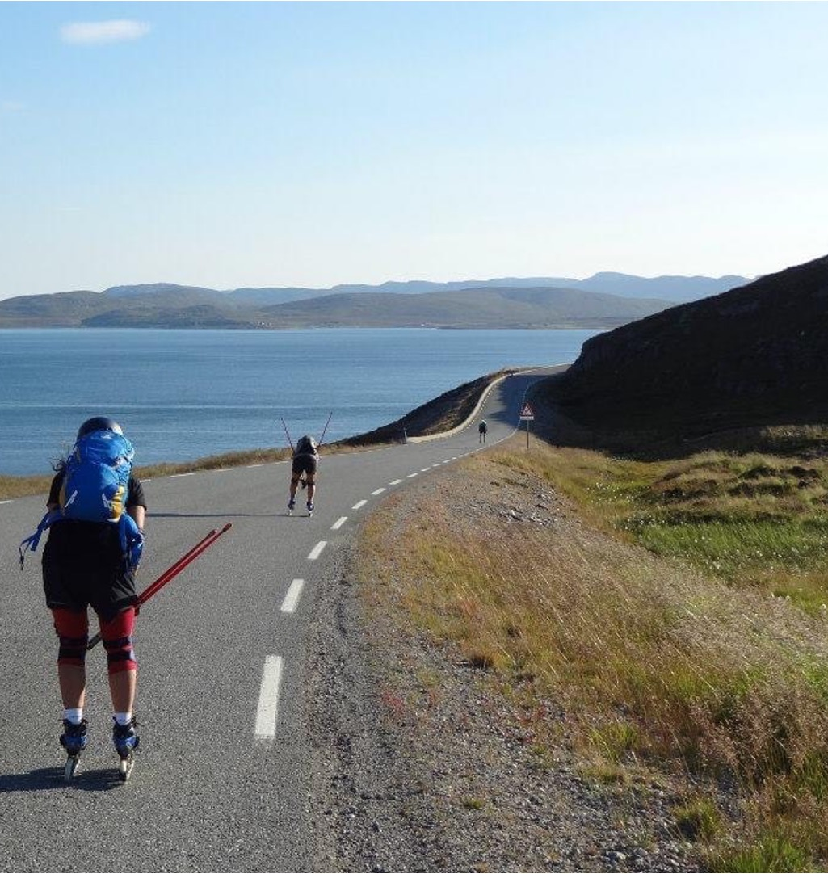
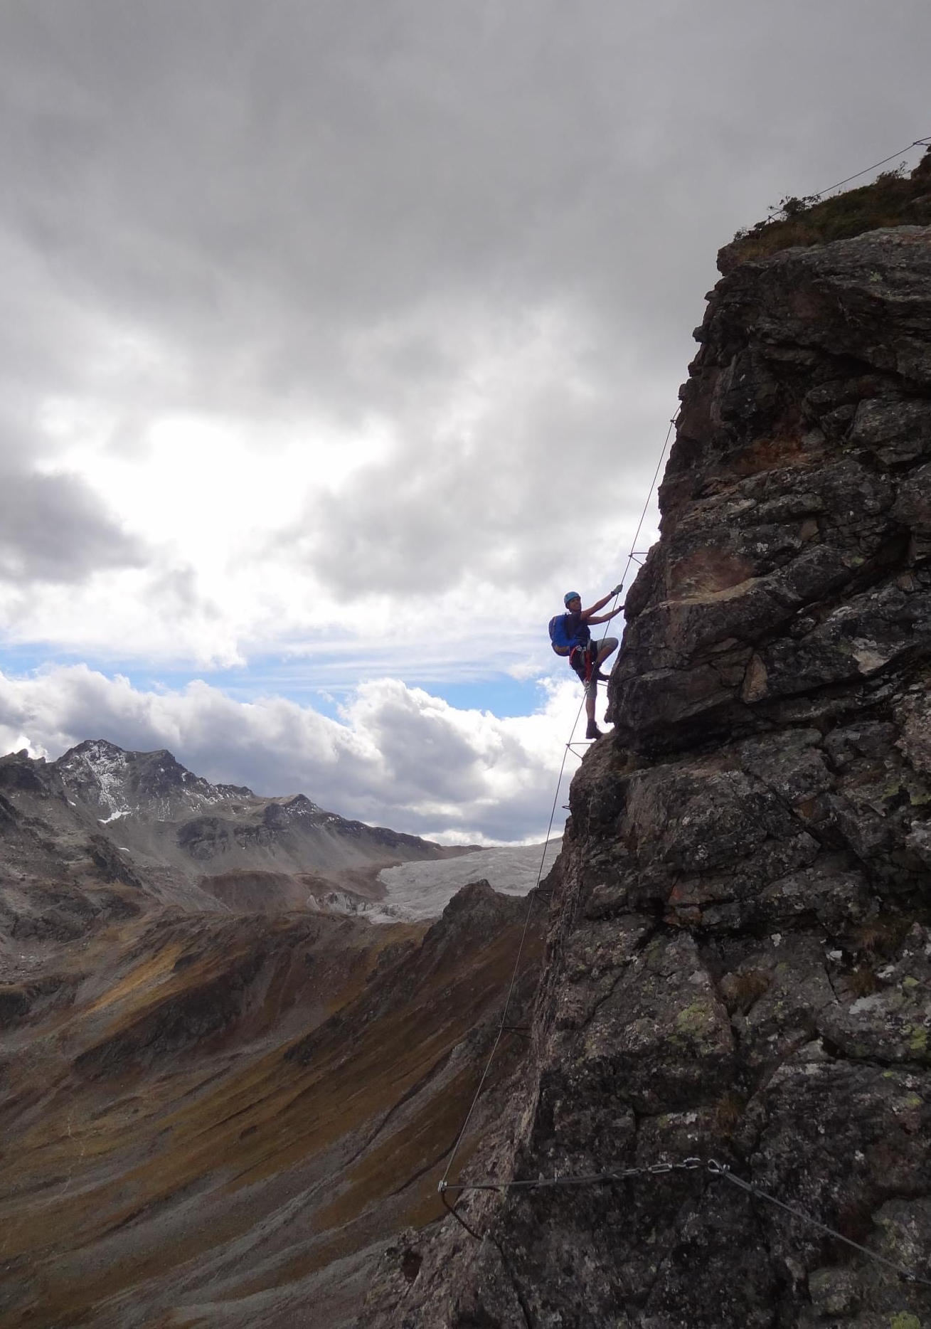
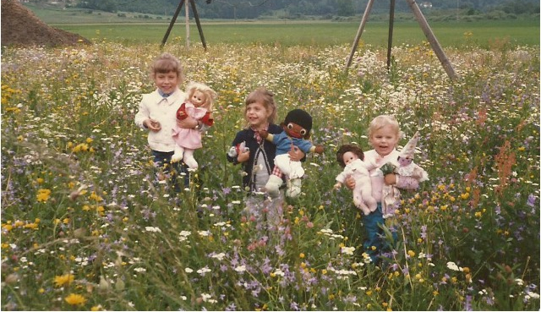
My personal journey- reflecting back
What are my favorite memories?
What is it I love about nature?
Why do I care?
What motivates me?
What inspires me?

Slide 15
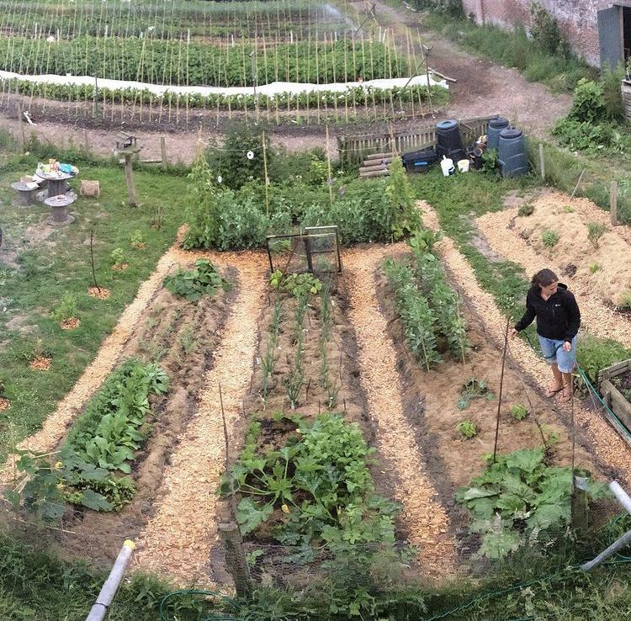
PLOT - Where do I start my own re- earthing? - Who do I do it with?

Slide 16
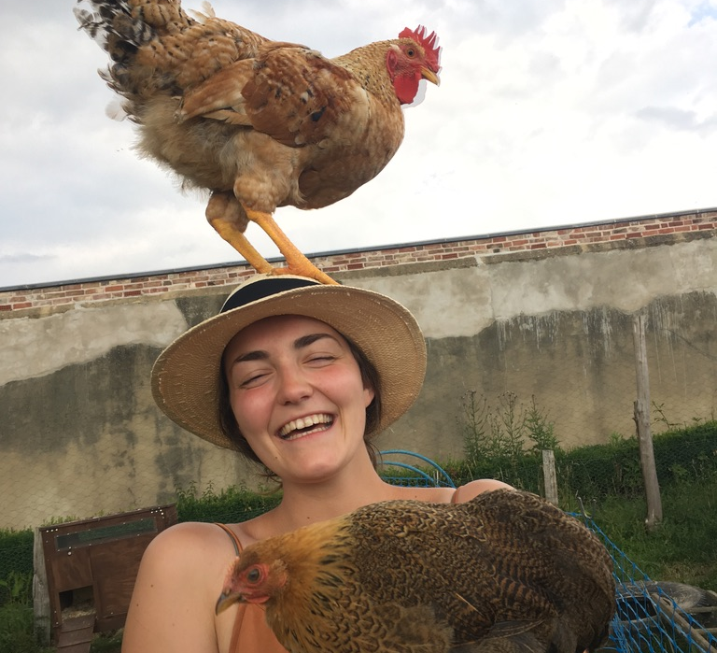
SOW - How do I include people in my journey? - Where do I start?

Slide 17
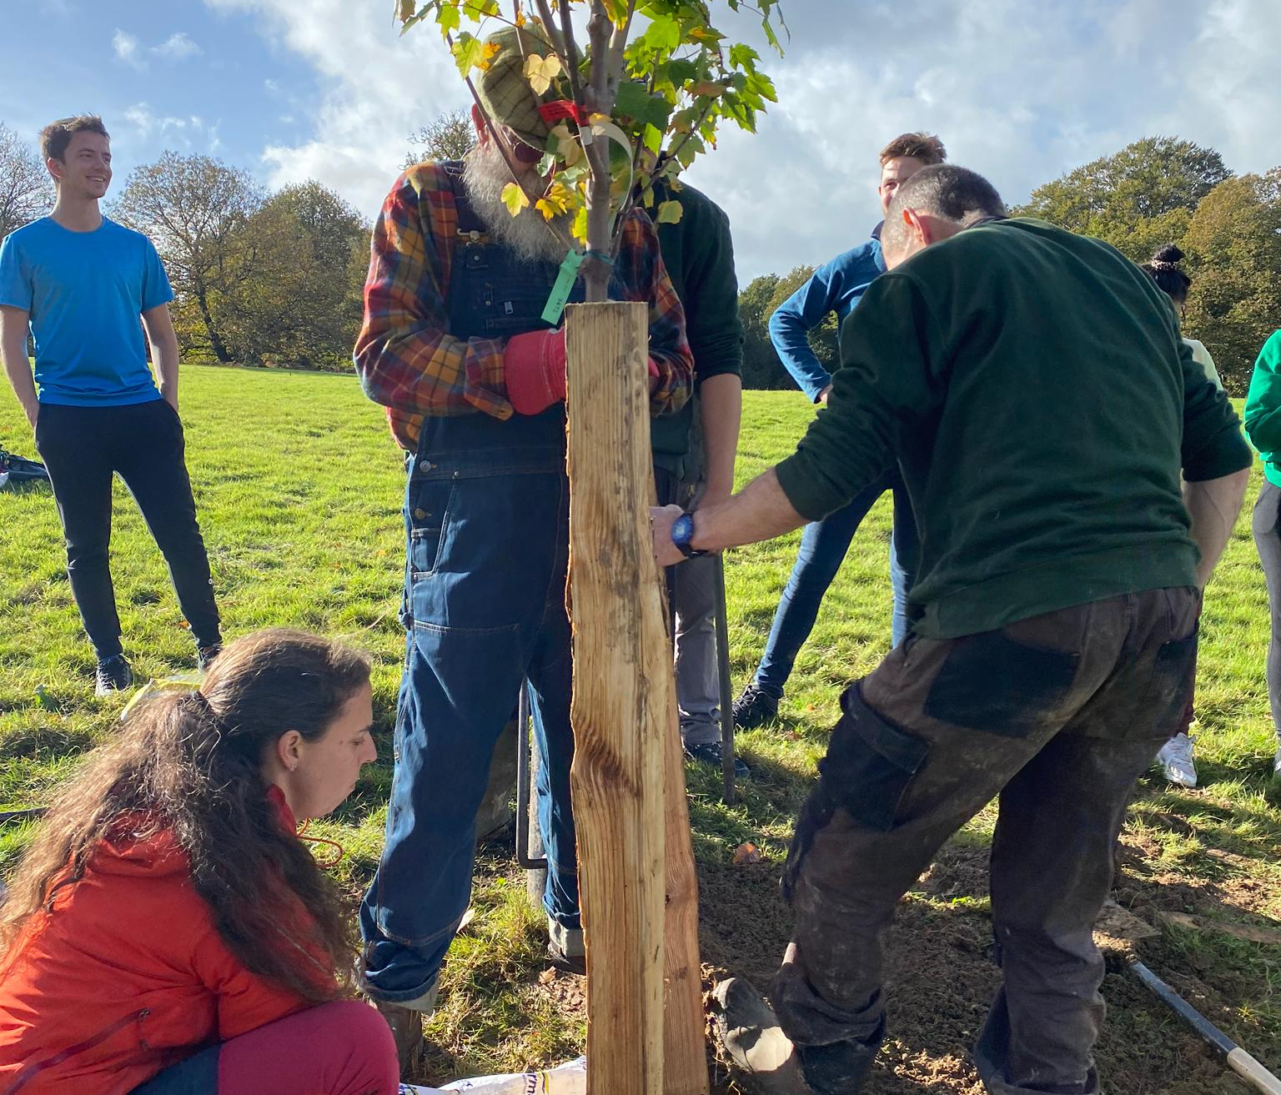
GROW - Where does this journey lead? - What is our goal? - What else do we consider?

Slide 18
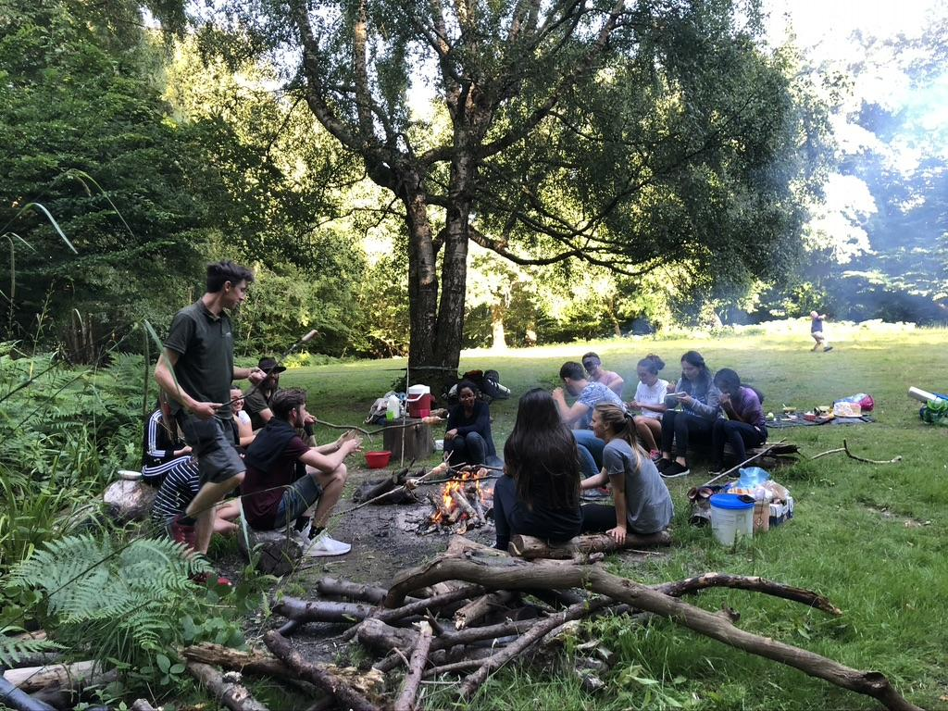
HARVEST - A celebration of what has been achieved - A space to share and enjoy - A process from celebrating to reflecting on what next!

Slide 19
Living differently in a time of crisis in 5 steps
Stop
Harvest
Plot
Grow
Sow

Slide 20
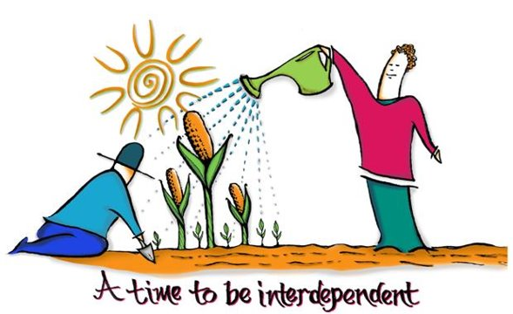

Slide 21
Living differently in a time of crisis in 5 steps
What will your 5 steps key steps for nature be for the land you look after?
Can personal action really change the future?
Can the worst impacts of climate change and nature loss still be avoided in the uplands?

Slide 22
Richard Louv (2005) Last Child in the Woods
'We cannot protect something we do not love, we cannot love what we do not know and we cannot know what we do not see. Or hear. Or sense’.

Slide 23
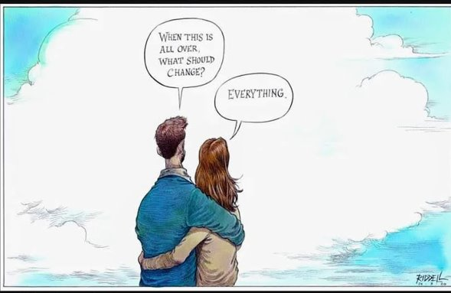

Slide 24
Hope is not lost…there is still time for adventure, creativity and amazing change. But we must act at scale and together . . .
Hebrews 11: 1 “Now faith is being confidence in what we hope for and assurance about what we do not see”

